Slide 1
MGS 723: Geodynamics
Fall 2021
Instructor: Adam F Holt

Slide 2
Instructor and course details
Instructor: Adam F Holt, Assistant Professor, RSMAS
My office: N202, RSMAS
Contact: aholt@rsmas.miami.edu
Office hours: Just shoot me an email.
Lectures: PowerPoint slides and derivations. I plan to save the derivations (on a stylus) and share at the end of class.

Slide 3
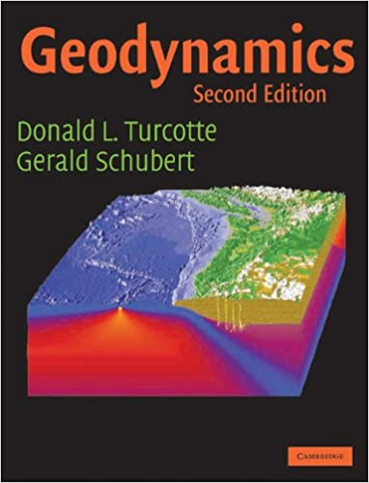
Instructor and course details
Instructor: Adam F Holt, Assistant Professor, RSMAS
My office: N202, RSMAS
Contact: aholt@rsmas.miami.edu
Office hours: Just shoot me an email.
Lectures: PowerPoint slides and derivations. I plan to save the derivations (on a stylus) and share at the end of class.
Textbook: Turcotte and Schubert
Available in RSMAS library, ~80$ on Amazon.
Free online copy: https://www.eps.mcgill.ca/~courses/c510/%5BTurcotte_D.L.,_Schubert_G.%5D_Geodynamics(Bookos.org).pdf

Slide 4
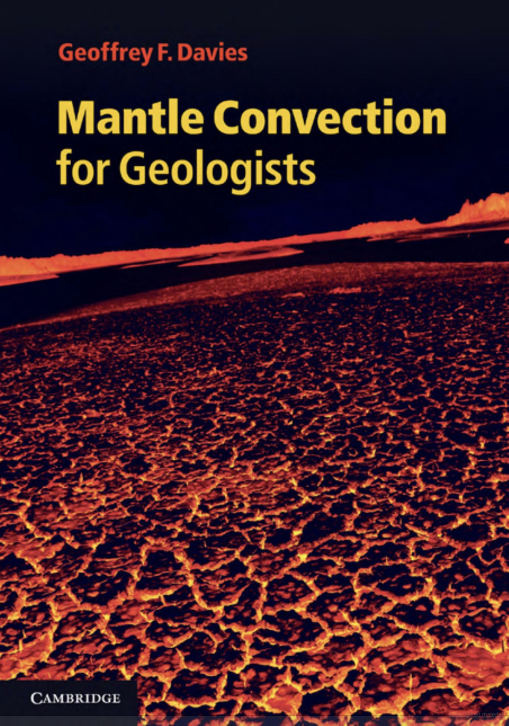
Other great books/resources
A qualitative description of mantle convection

Slide 5
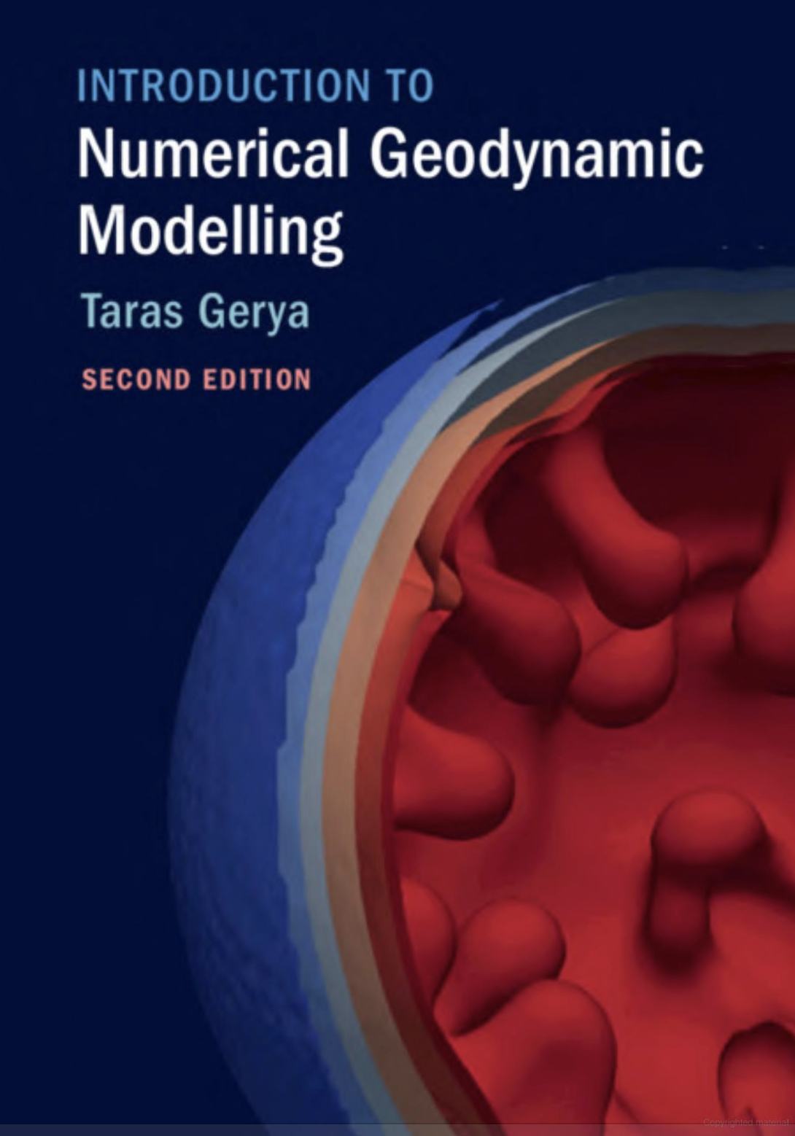
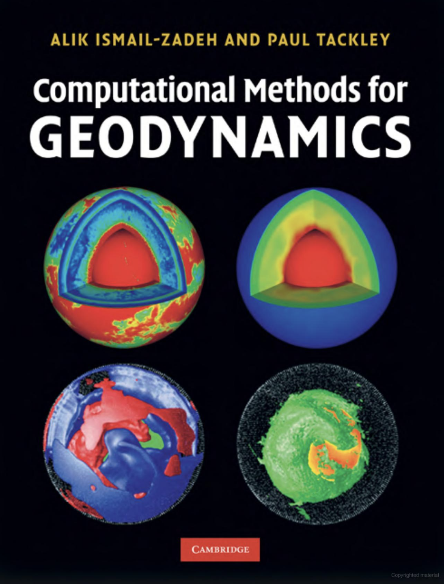
Other great books/resources
A qualitative description of mantle convection
Modeling overview
Numerical modeling in geodynamics:
Finite difference method

Slide 6
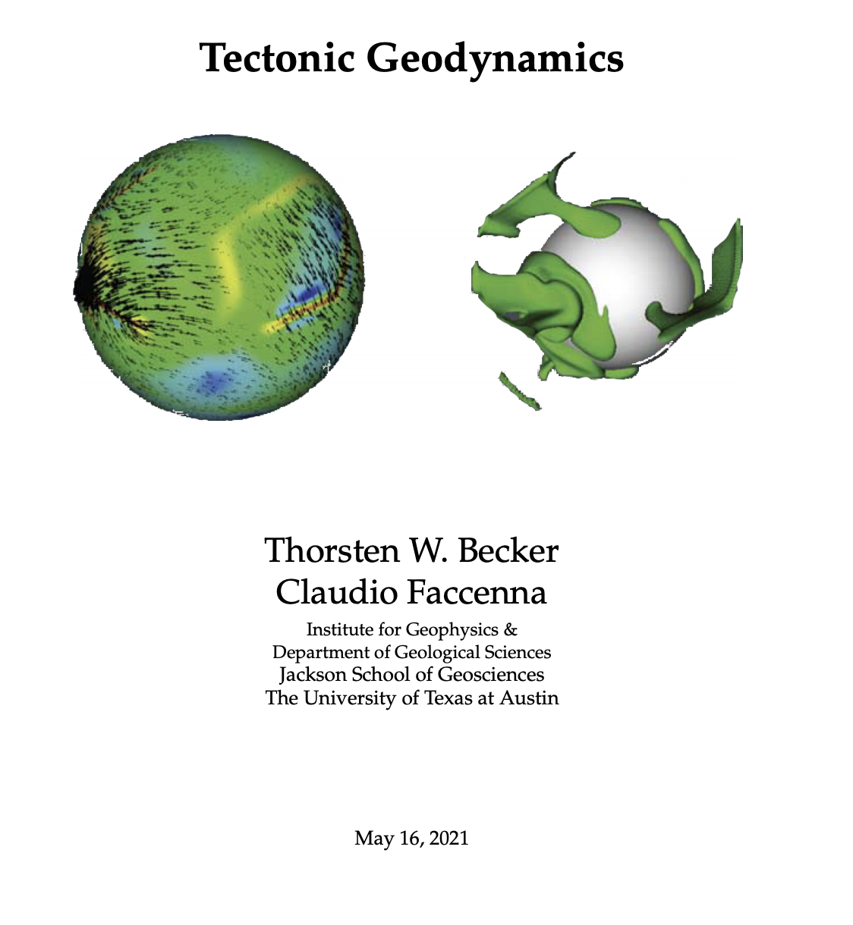
Other great books/resources
Tectonic Geodynamics: forthcoming textbook (draft online)
A qualitative description of mantle convection
By Thorsten Becker & Claudio Faccenna, UT Austin
Modeling overview
Numerical modeling in geodynamics:
~Turcotte and Schubert + tectonic applications + modern research
Finite difference method
http://www-udc.ig.utexas.edu/external/becker/preprints/tectonic_geodynamics_draft.pdf

Slide 7

Introductions

Slide 8
What is Geodynamics?

Slide 9
What is Geodynamics?
Dynamics of the Earth

Slide 10
What is Geodynamics?
Dynamics of the Earth
The motion of bodies under the action of forces.

Slide 11
What is Geodynamics?
Dynamics of the Earth
The motion of bodies under the action of forces.
Figuring out the forces that shape motions and deformations on Earth!

Slide 12
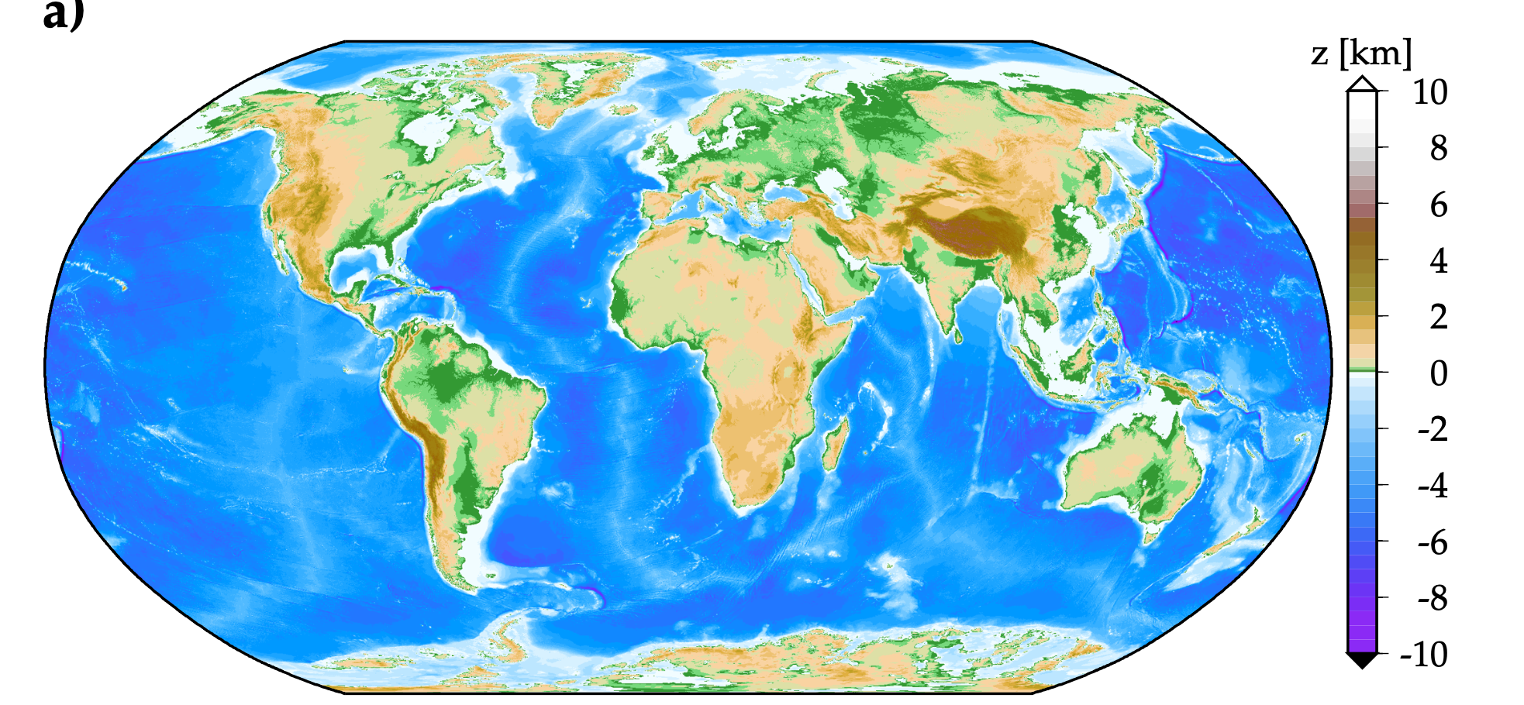
Many relevant types and scales of Earth deformation
e.g., topography

Slide 13
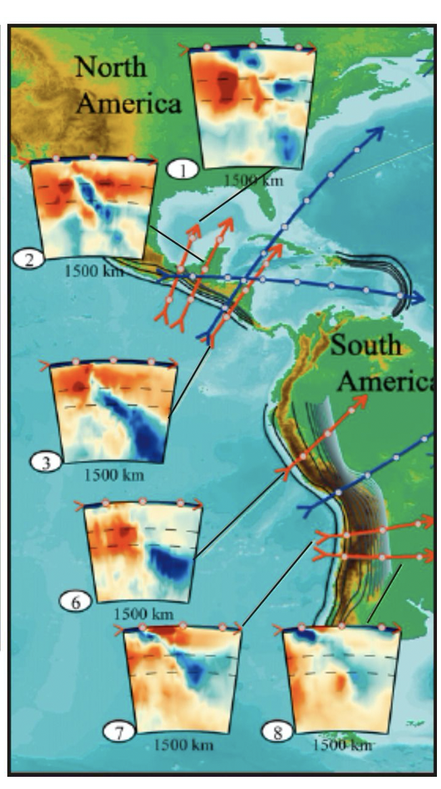
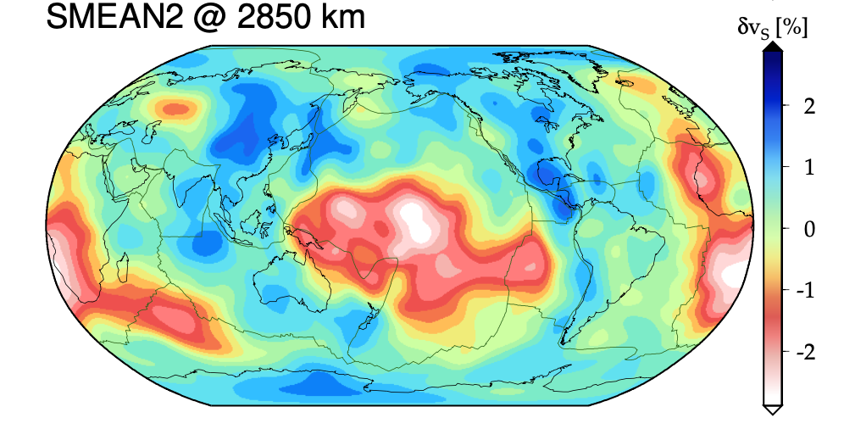
Many relevant types and scales of Earth deformation
e.g., topography
tomography

Slide 14
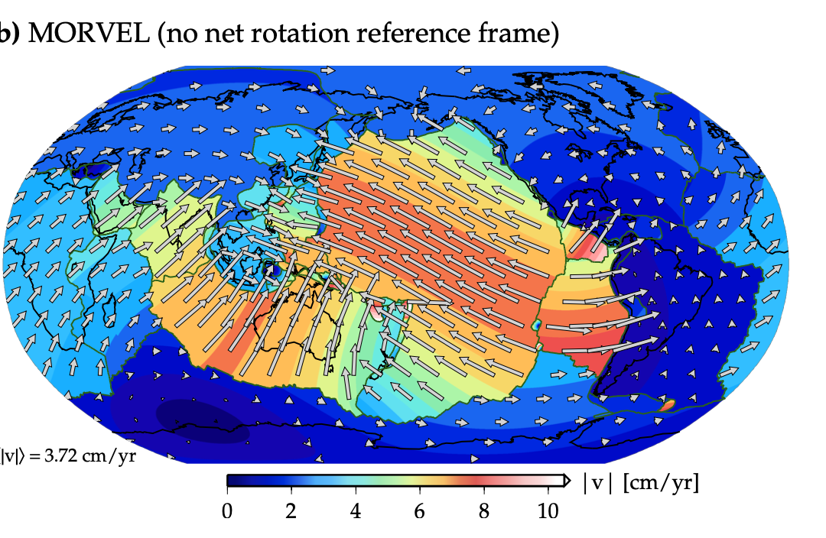
Many relevant types and scales of Earth deformation
e.g., topography
tomography
plate velocities

Slide 15
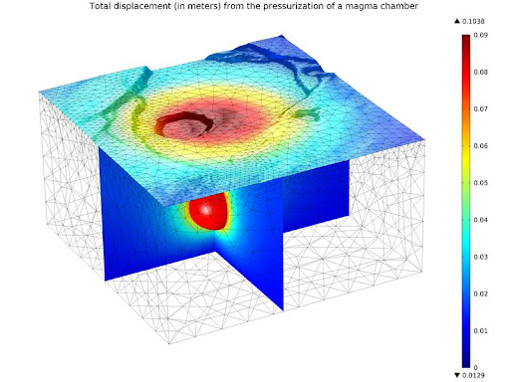
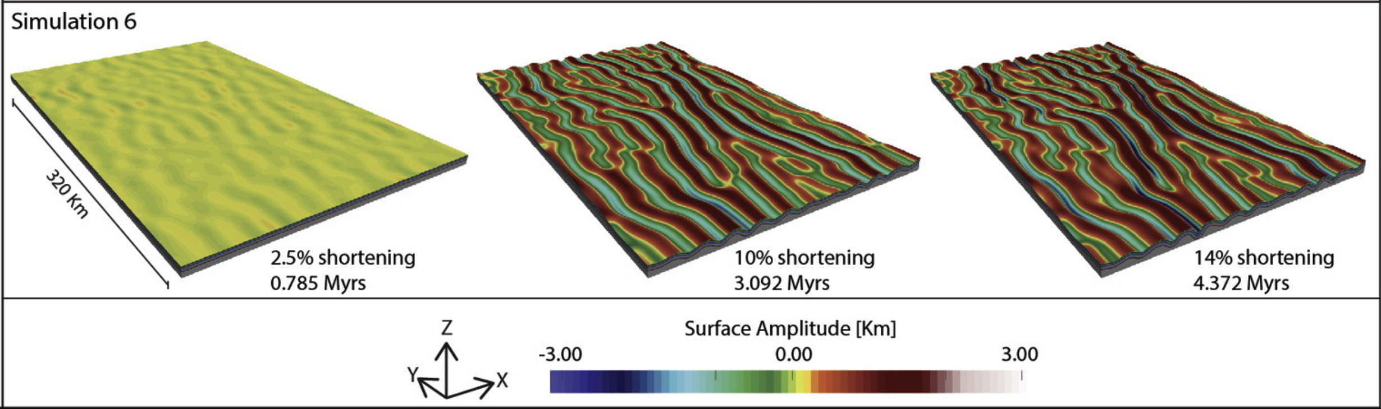
Many relevant types and scales of Earth deformation
Deformation at the regional scale
e.g., volcanoes
folding

Slide 16
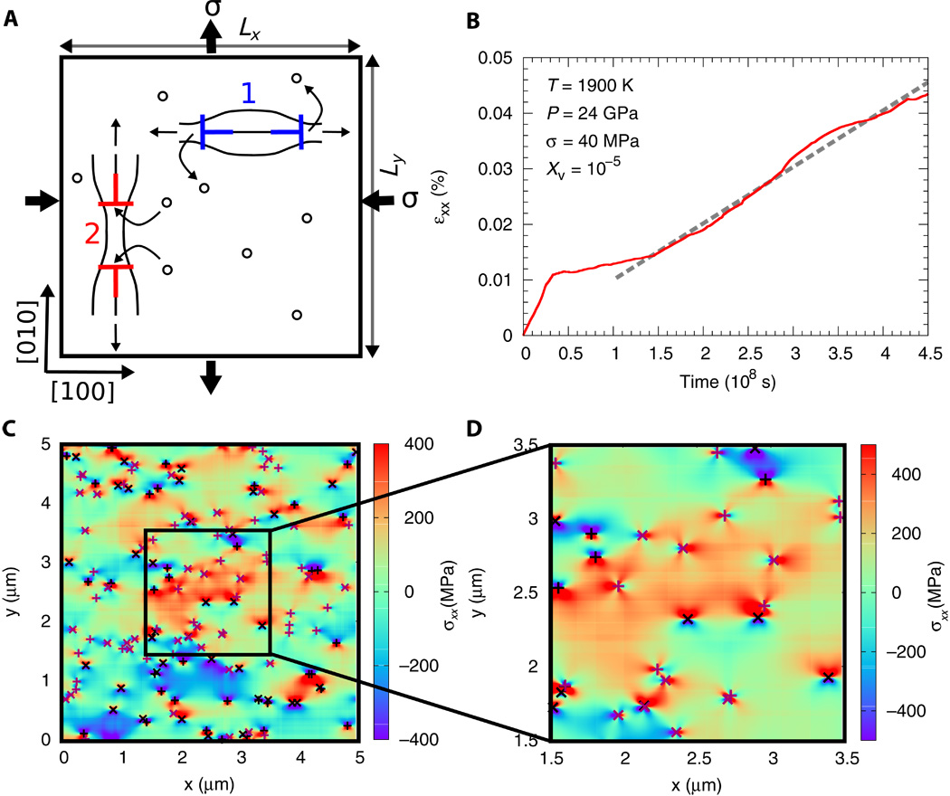
Many relevant types and scales of Earth deformation
Deformation at the individual grain scale
Rock creep mechanisms involve the motion of crystal defects at the atomic scale.
tomography
Boioli et al., 2017, Sci. Adv.
Notes:
Fig. 3 Pure climb creep simulation in bridgmanite.
(A) Sketch of the 2D simulation box and of the loading condition. The chosen loading conditions were set in analogy with the conditions usually used for describing NH creep. They correspond to a pure shear loading. Two slip systems are considered. Here, dislocations characterized by [010] Burgers vector (labeled as “1” and shown in blue) move in response to the tensile stress along the [100] climb direction by emitting vacancies. The excess of vacancies created by these dislocations is absorbed by the dislocations with [100] Burgers vector (slip system as “2” and shown in red), which move in response to the compressive stress along the [100] direction by absorbing vacancies. (B) DD stress-strain curve obtained by applying a creep stress σ of 40 MPa at T = 1900 K and P = 24 GPa. In this particular case, the initial dislocation density is 10¹² m⁻², and an equilibrium vacancy concentration of X_{v} = 10⁻⁵ is assumed. After an initial transient stage where dislocation multiplication occurs, the steady state is attained and the steady-state strain rate value is extracted (dashed line slope). (C) Dislocation microstructure and σ_{xx} stress field extracted from the creep simulation at ε_{xx} = 0.045%. (D) Detail of the dislocation microstructure shown in (C). Black (purple) symbols indicate the dislocations with [100] ([010]) Burgers vector, whereas plus (cross) symbols are used to denote the positive (negative) sign of their Burgers vector.

Slide 17
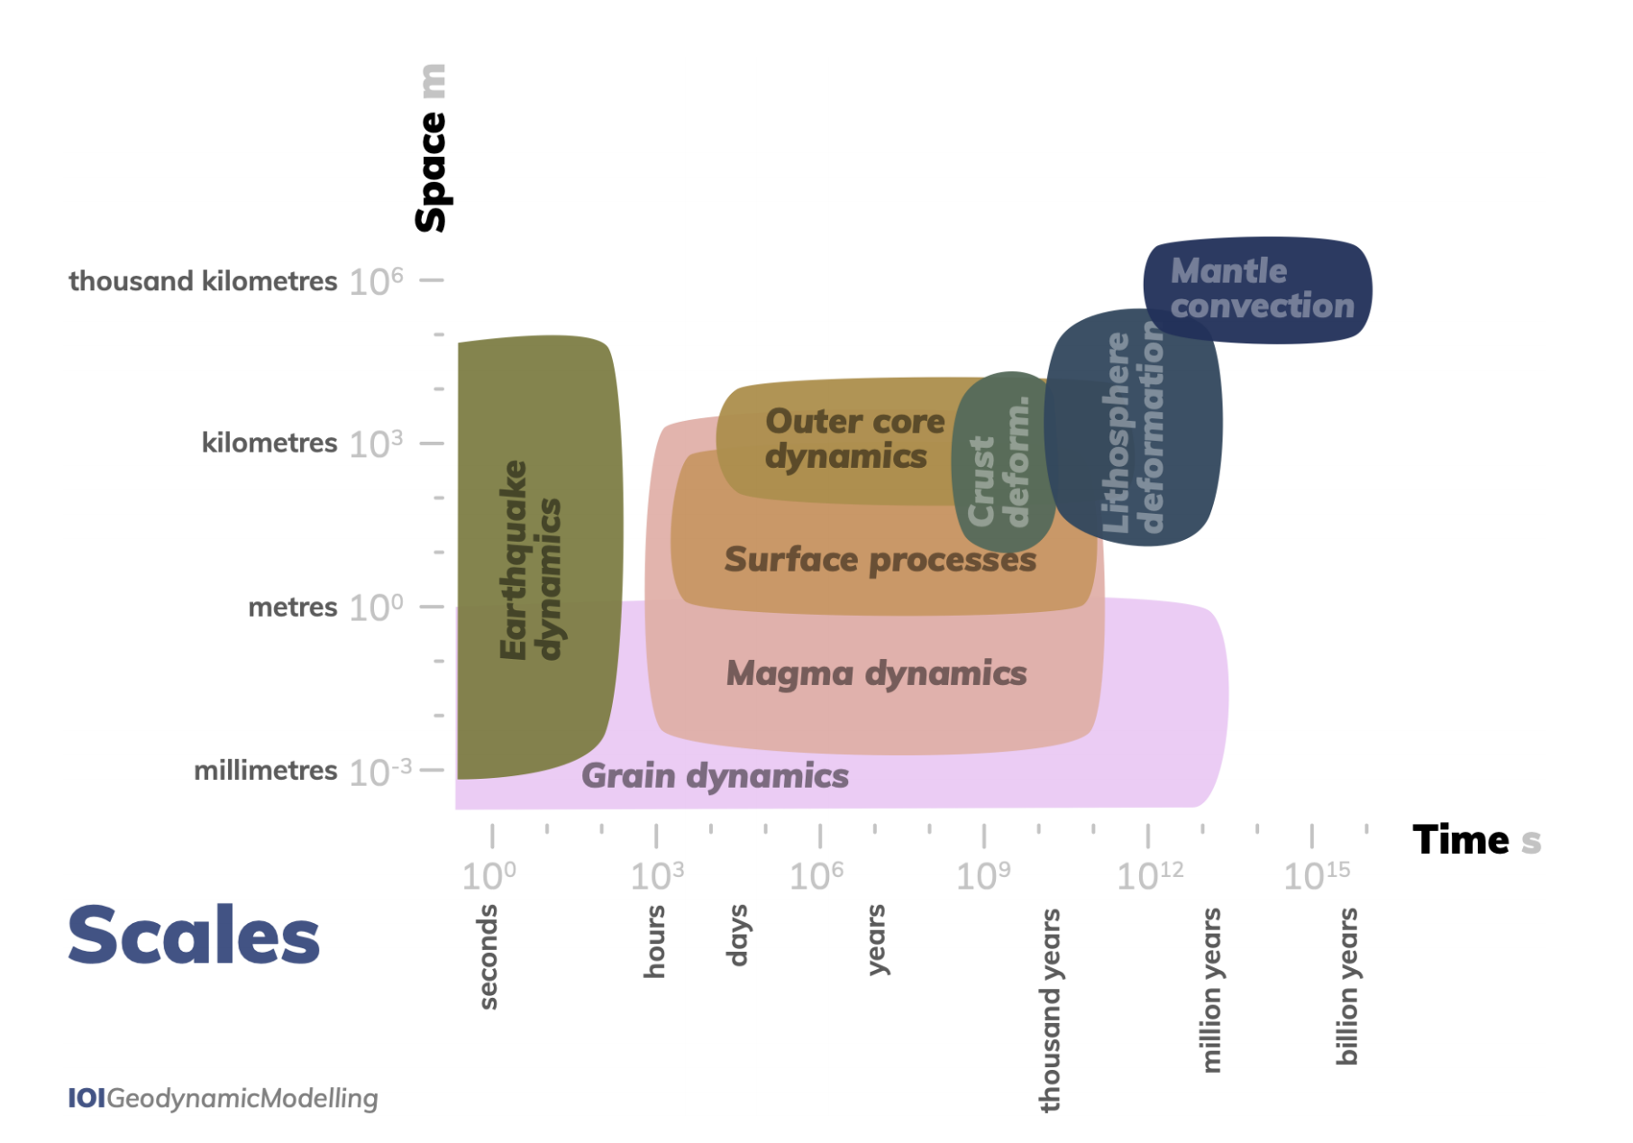
Many relevant types and scales of Earth deformation
van Zelst et al., 2021, https://doi.org/10.5194/se-2021-14

Slide 18
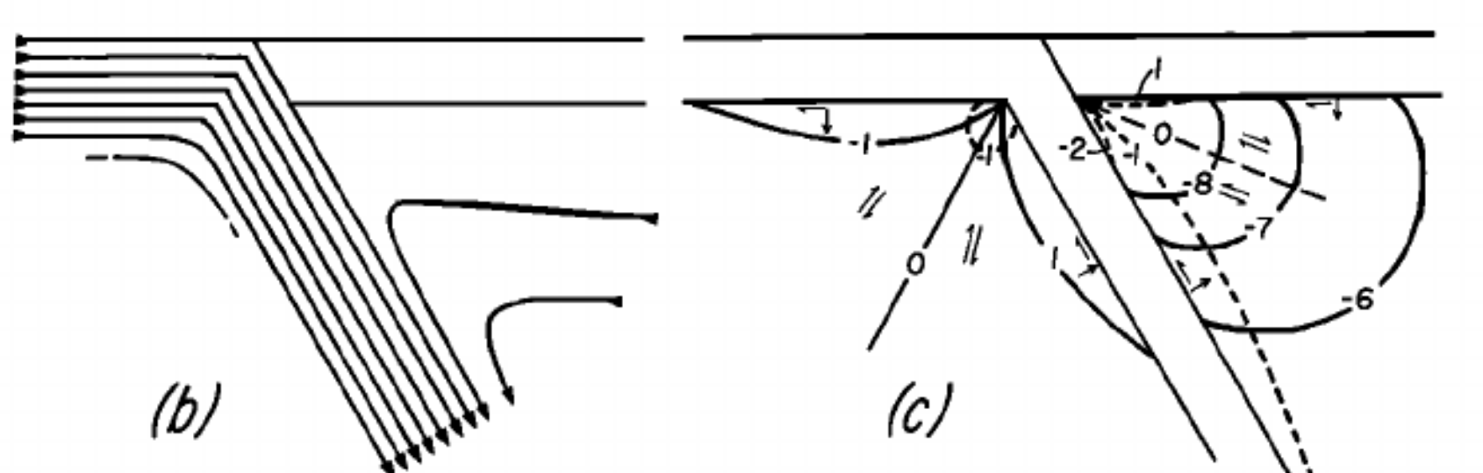
How do we use Geodynamics to investigate?
Modeling!
Analytical
Tovish et al., 1978, JGR

Slide 19
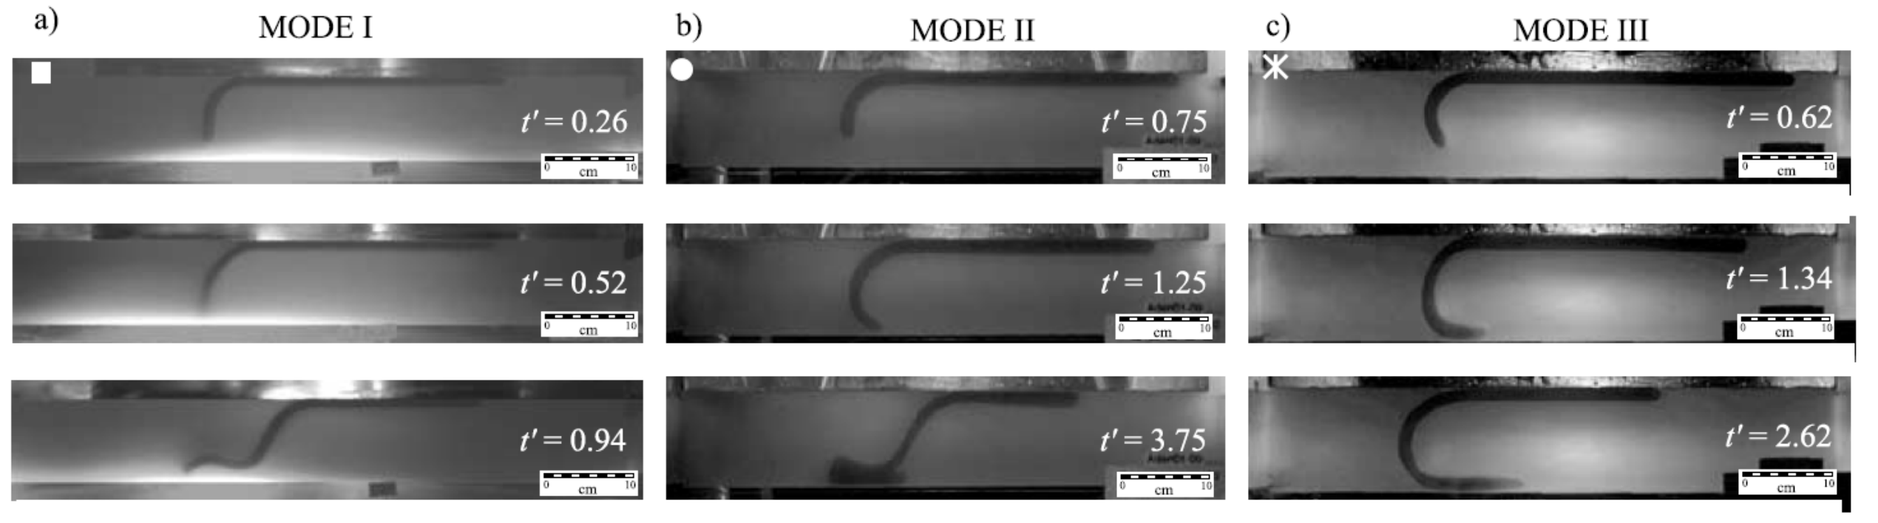
How do we use Geodynamics to investigate?
Modeling!
Analytical
Tovish et al., 1978, JGR
Analog/laboratory
Bellahsen et al., JGR, 2005

Slide 20
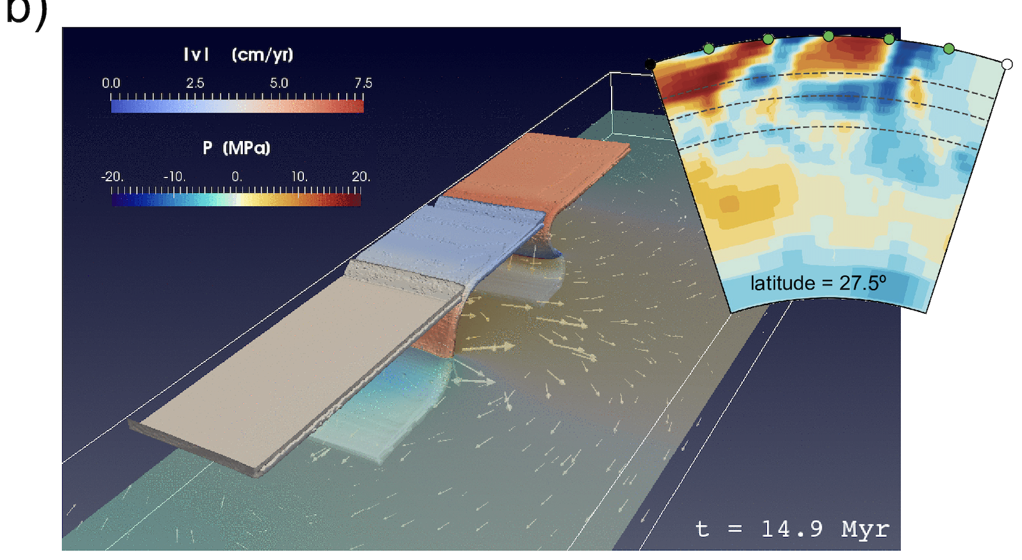
How do we use Geodynamics to investigate?
Modeling!
Analytical
Numerical
Tovish et al., 1978, JGR
Analog/laboratory
Bellahsen et al., JGR, 2005

Slide 21
How do we use Geodynamics to investigate?
Modeling!
Analytical
Numerical
Tovish et al., 1978, JGR
Analog/laboratory
Bellahsen et al., JGR, 2005

Slide 22
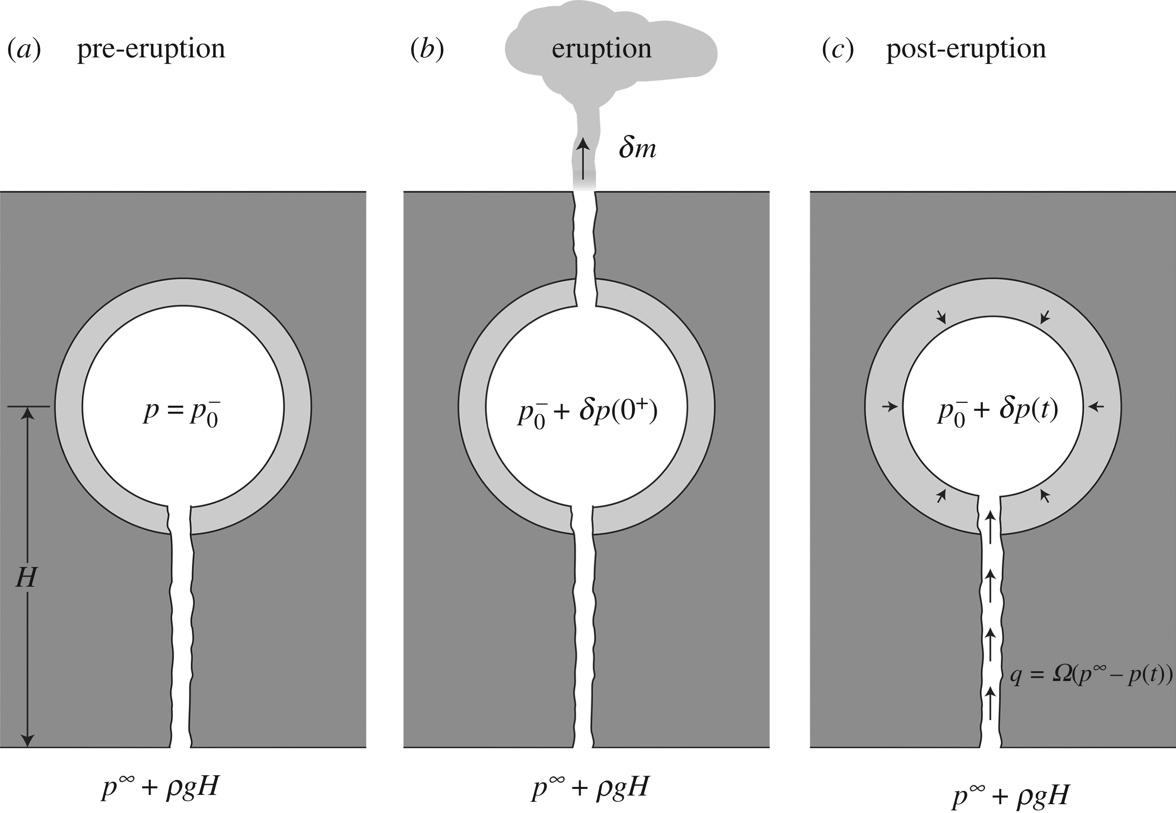
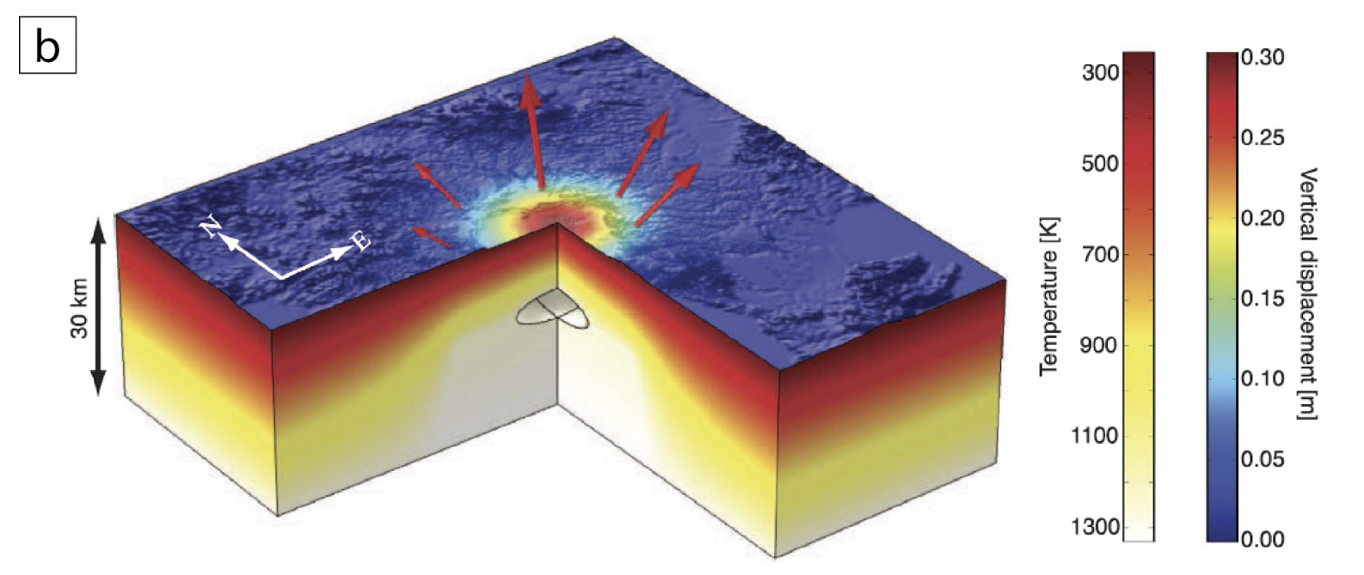
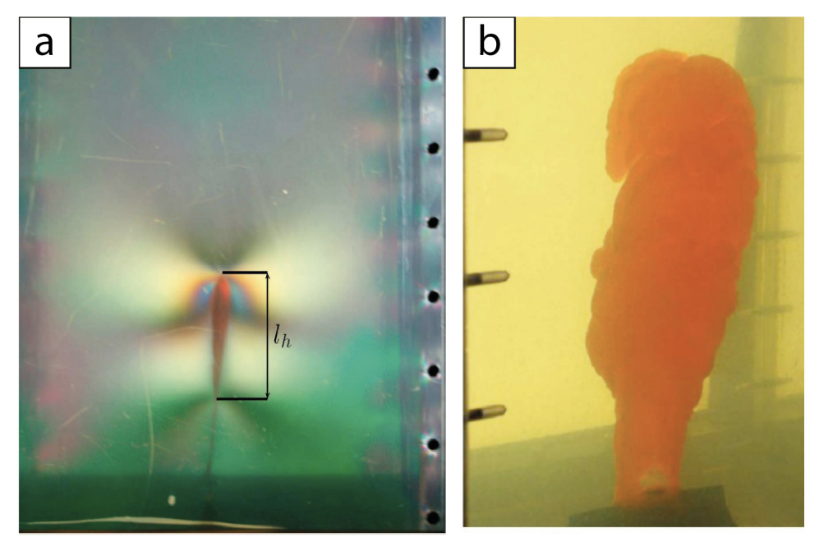
How do we use Geodynamics to investigate?
Modeling!
Analytical
Numerical
Hickey et al., 2016
Analog/laboratory
Segall et al., 2019
Taisne and Tait, 2011:
Dyke propagation

Slide 23
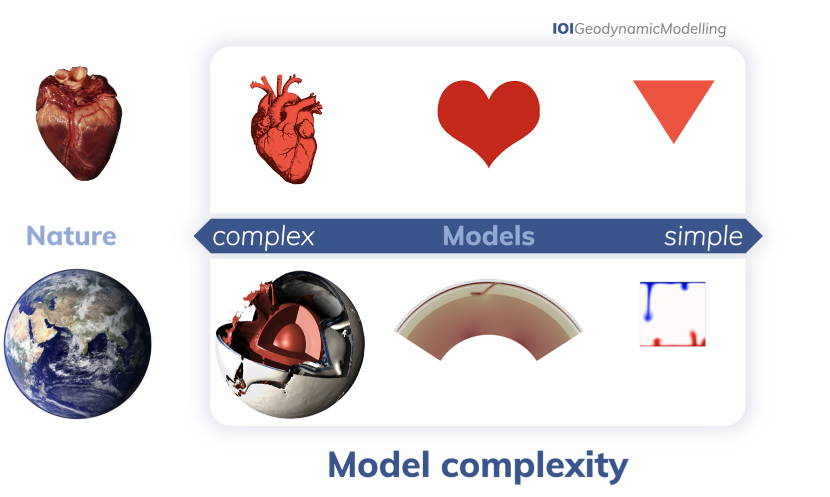
How do we use Geodynamics to investigate?
Modeling!
van Zelst et al., 2021, https://doi.org/10.5194/se-2021-14

Slide 24
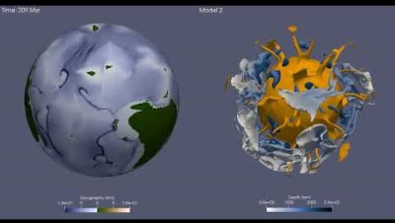
A complex geodynamic model
The movie shows the temporal evolution of surface topography (left panel) and mantle cold (slabs in blue) and hot (plumes in orange) heterogeneities (right panel) in global models of mantle convection self-generating plate-like tectonics with the StagYY code.
Arnould et al., 2020, EPSL

Slide 25
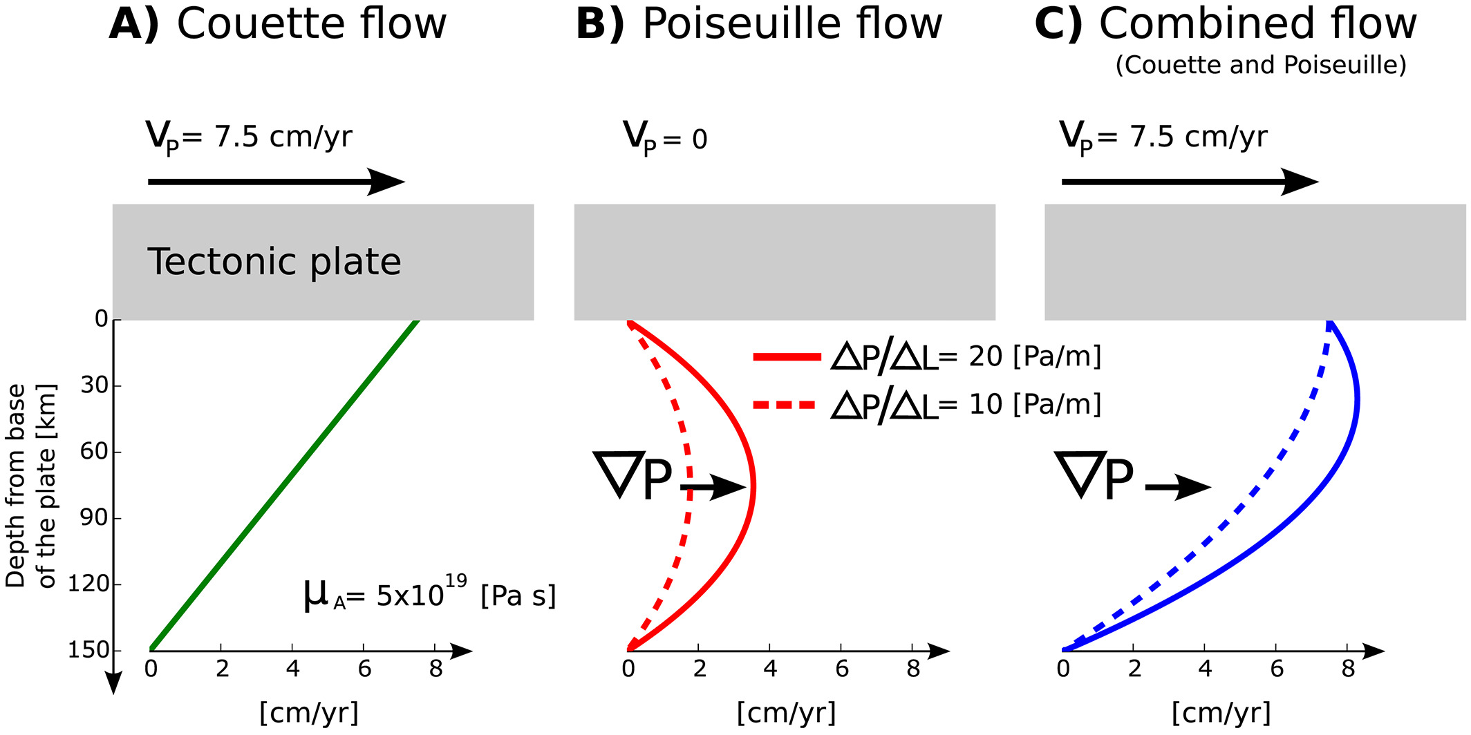
A simple geodynamic model
Stotz et al., 2017, GRL

Slide 26
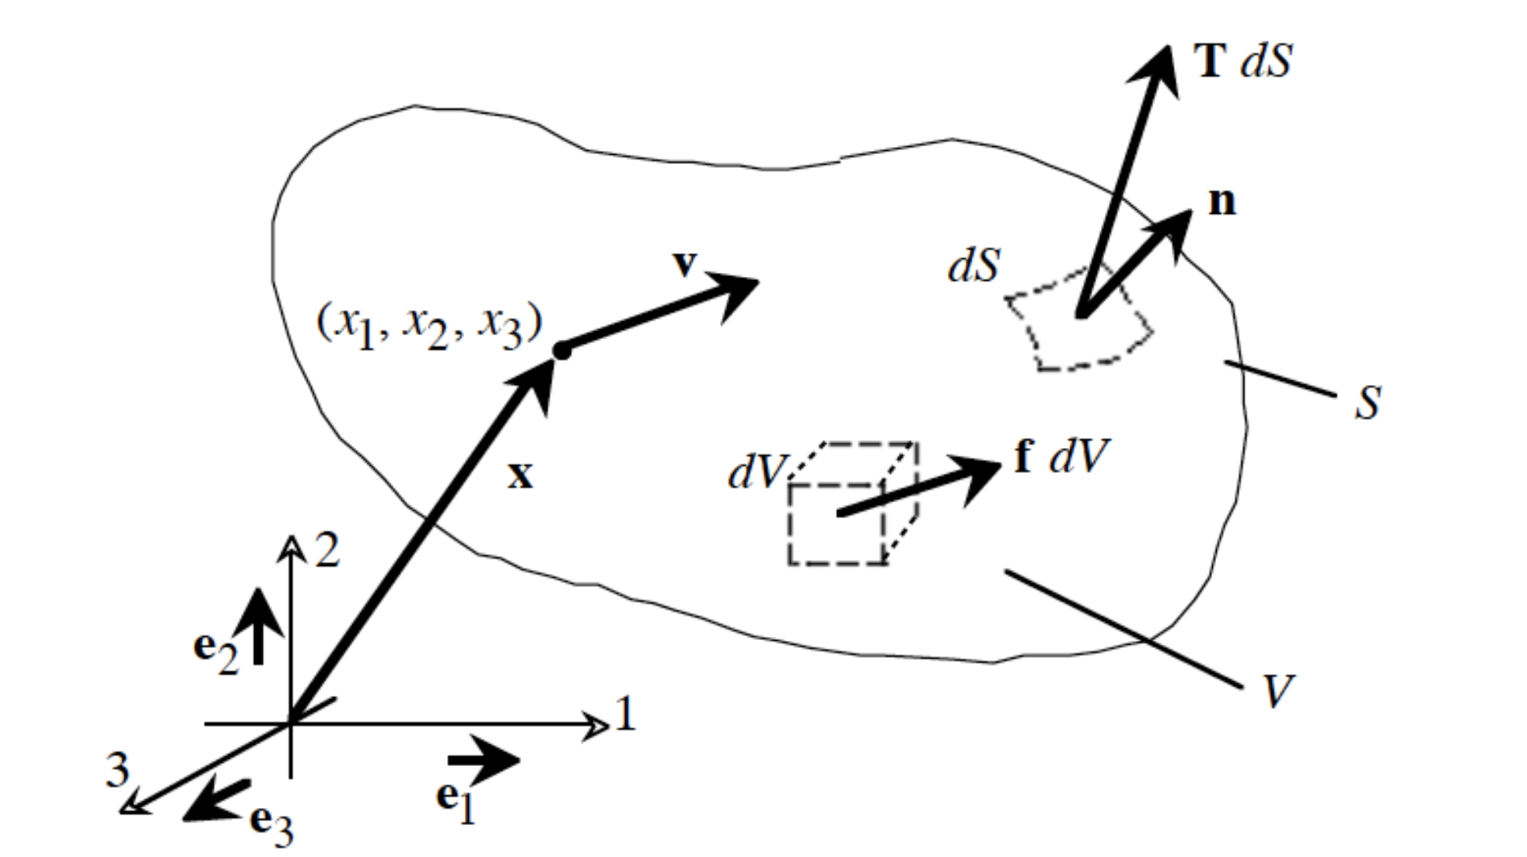
Setting up these models: Earth as a continuum
In Geodynamics, we typically treat the Earth as a continuum.
That is, properties vary smoothly throughout a continuous mass. Matter completely fills space (i.e., relevant for length scales >> atoms).

Slide 27
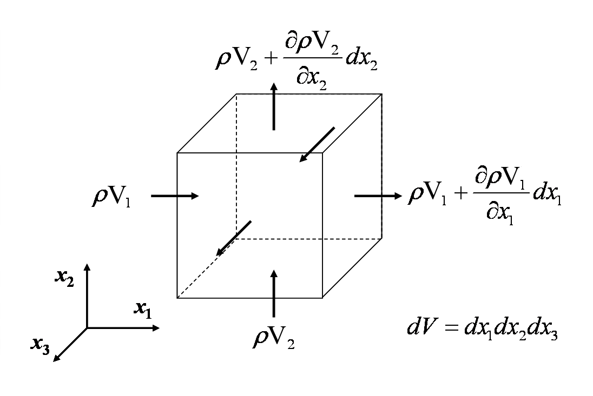
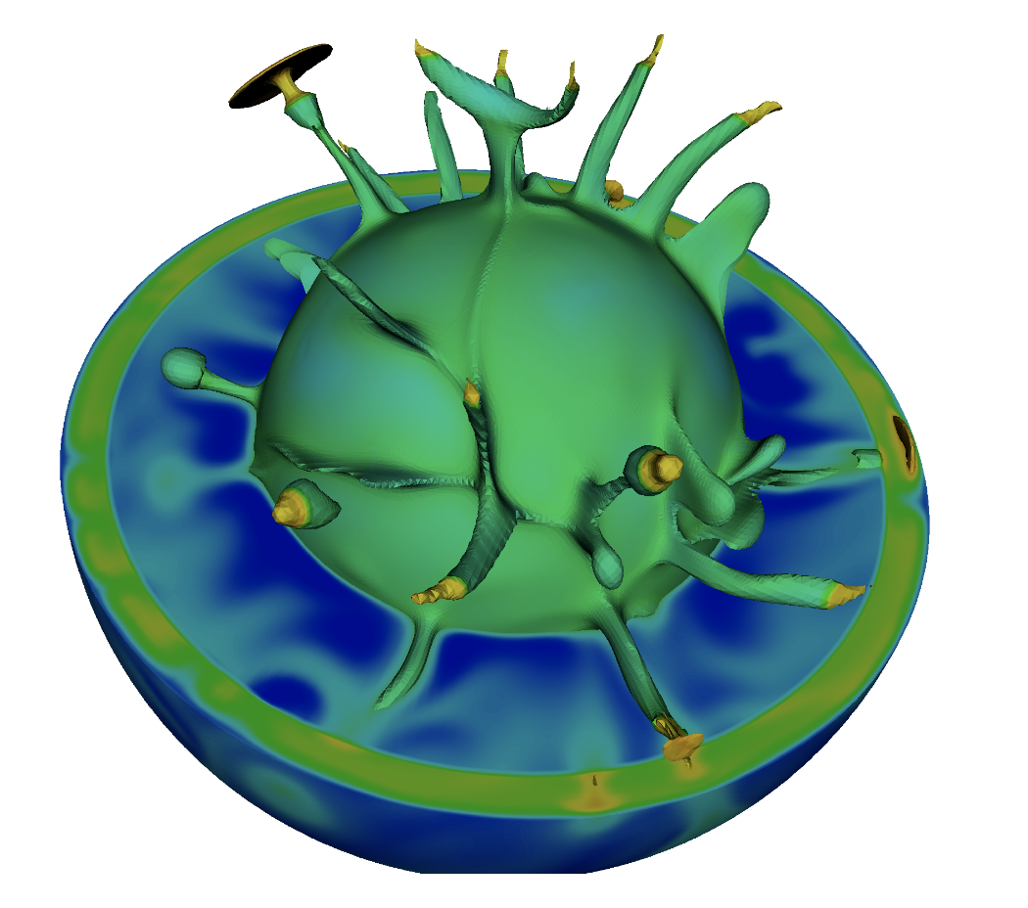
Setting up these models: Earth as a continuum
In Geodynamics, we typically treat the Earth as a continuum.
That is, properties vary smoothly throughout a continuous mass. Matter completely fills space (i.e., relevant for length scales >> atoms).
Useful mathematically: Can break up the continuum into tiny chunks.

Slide 28
Overarching goals of this class
Be able to use continuum mechanics to understand first-order controls on elastic deformation, heat transfer, fluid motions, convection, …
Be able to set up analogous expressions to test the validity of physical processes within your field-of-interest.
Understand methods commonly used to solve the equivalent expressions within computer programs and be able to set up programs to model relatively simple processes (e.g., heat transfer)

Slide 29
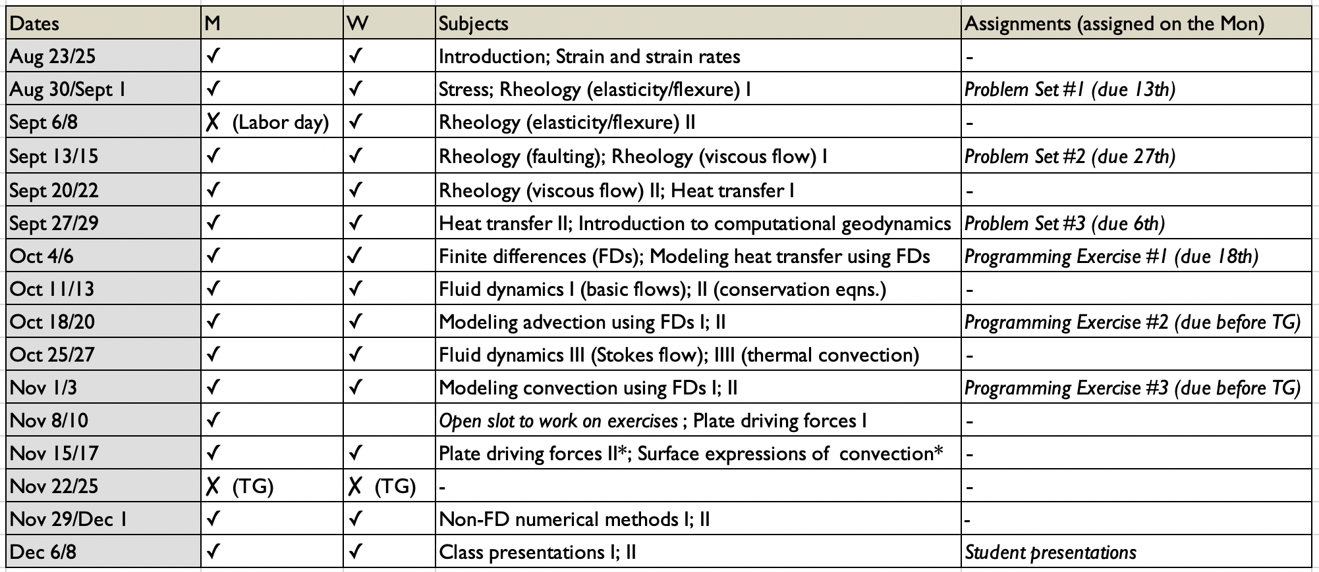
Tentative schedule:
Grade breakdown:
60% problem sets (~ every 2 weeks)
15% participation
25% term project

Slide 30
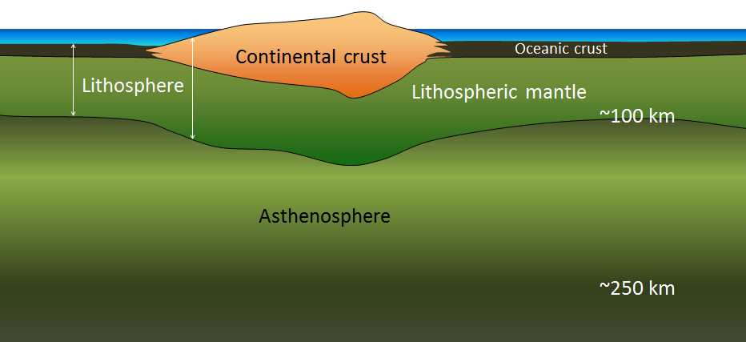

Slide 31
What physical properties define the lithosphere relative to the asthenosphere? (density, temperature, viscosity)
What physical properties define the continental crust relative to the oceanic crust? (thickness, density, viscosity)
Why is topography greater within continents?

